Slide 1

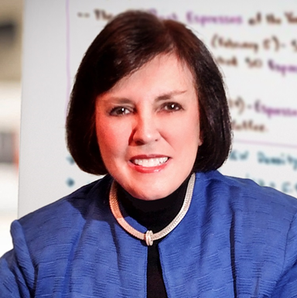
2025: Unlocking Explosive LO Sales Growth
Pat Sherlock
QFS Sales Solutions
Pat Sherlock--copyright@patsherlock2025

Slide 2
Are Your LOs Hitting Their Sales Goals?
✅ If the answer is 'No' or 'Not Enough', your profitability is at risk
✅ The Solution: More LOs or More Sales from existing LOs?
🔹 Option 1: Recruit aggressively & pay more (expensive & risky)
🔹 Option 2: Develop your current team to dominate referrals (smarter & scalable)
Smart lenders don’t just hire: They maximize what they already have!

Slide 3
What’s the FASTEST Way to Boost LO Sales?
More Loan Products?: No. If they can’t sell current products, more products won’t help
More Technology?: No. Tech won’t close deals or build relationships
“Theory only Training” with No Application
✅ Elite Sales Training? YES!
The problem isn’t the market—It’s Weak Sales Execution:
🔹 Inconsistent Prospecting & Not Enough Referral Sources
🔹 Lack of Confidence for Asking for the Business
🔹 Weak Relationship-Building Skills
Fix these = Higher Closings, More Volume, Bigger Profits!

Slide 4
The QFS Difference: Prospecting Training That WORKS
Our training is designed for impact and measurable results:
✅ Assess first – Only train LOs with real sales potential
✅ Teach structured, repeatable sales systems that thrive in any market
✅ Train LIVE via webcam for accountability and instant feedback. We require LOs practice in real time –No Passive Learning
Repetition + Accountability = New Selling Habits That Stick

Slide 5
Our Proven Training Framework
We Turn LOs into Referral Machines
🔹 Step 1: Identify Ideal Referral Partners : Target high-value realtors & clients. Develop a Powerful Value Prop
🔹 Step 2: Master Proven Scripts : No more guesswork—LOs know exactly what to say & do. Leverage Social Selling – Build authority & become top of mind
🔹 Step 3: Key Part of Program: 30 days of Power Hour Prospecting – Applying prospecting techniques to grow their referral sources
Our system works in ANY market – Up or Down

Slide 6
The Cost of Waiting = Lost Deals
Every day without a structured prospecting strategy = LOST REVENUE
Every LO without a system = Deals going to your competitors
Success isn’t about trying harder—it’s about prospecting smarter
QFS = Tactical. Actionable. Guaranteed Results.
Don’t wait. Let’s help you build a high-performing sales force NOW!

Slide 7
Contact Information
psherlock@qfsconsulting.com
609-953-4077 office
215-527-0547 cell

